Slide 1
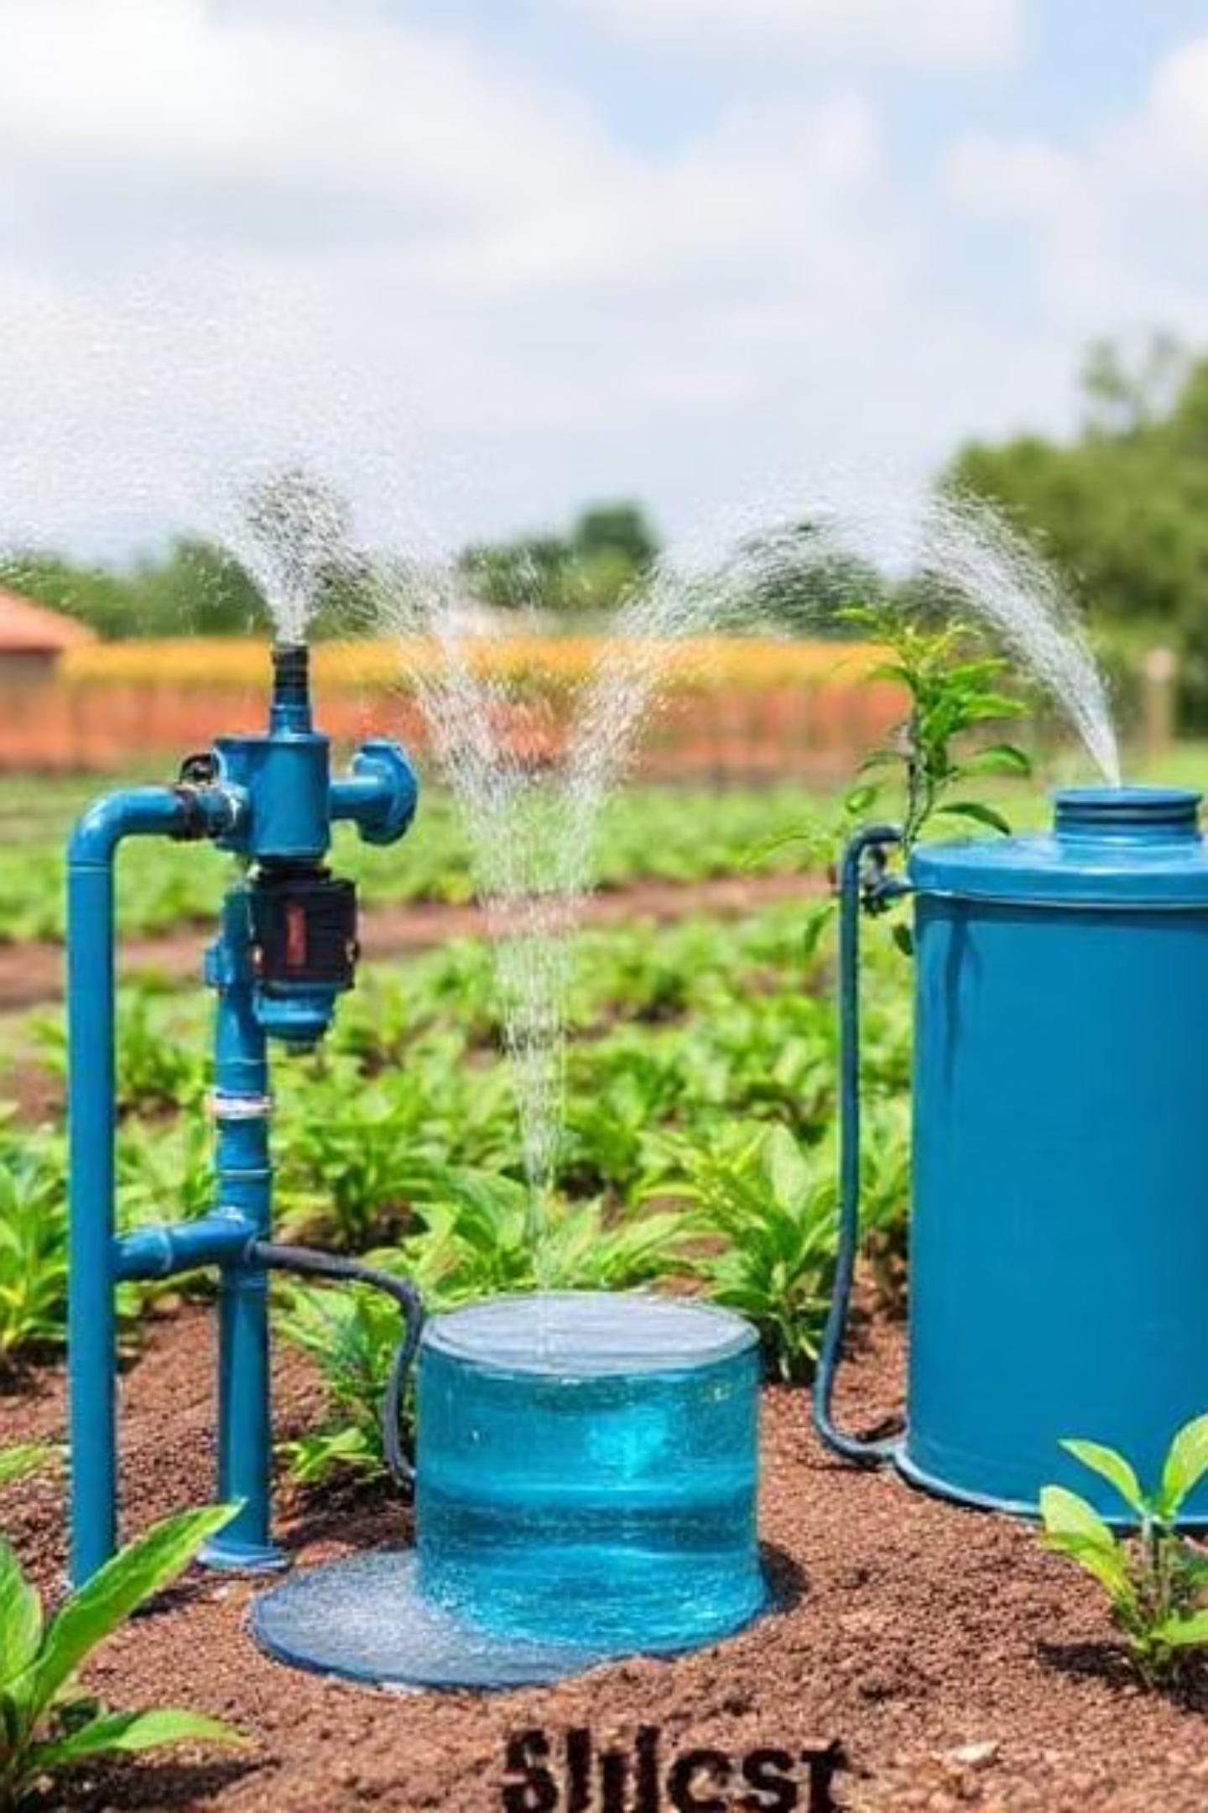

IoT Based Smart Irrigation and Rainwater Harvesting System

Slide 2

Subject: ECE279
Section and Group: K25BR / Group 2
Group Members:
Vikash Kumar - Roll No: 61 - Reg. No: 12514494
Hrishi - Roll No: 62 - Reg. No: 12515480
Yash - Roll No: 63 - Reg. No: 12516069
Rituraj Kumar Singh - Roll No: 64 - Reg. No: 12510724

Slide 3

Problem Statement
In modern agriculture, one of the major challenges faced by farmers is inefficient water usage due to traditional irrigation methods and lack of real-time environmental data. To overcome these issues, an intelligent system is needed that monitors soil moisture, temperature, and weather conditions while optimizing water usage automatically. Our project integrates IoT technology with a rainwater harvesting system and drip irrigation to create a sustainable and efficient irrigation method.

Slide 4

Objectives
To design an IoT-based system that monitors soil moisture and temperature in real-time.
To automate water release based on the moisture level and crop requirement.
To integrate rainwater harvesting with an intelligent control mechanism.
To use Google Weather API to prevent water wastage during rainfall conditions.
To provide farmers with live data and remote control through a mobile application.
To suggest suitable crops, fertilizers, and agricultural tips based on data analytics.

Slide 5

Literature Review
In 2020, a project titled 'Smart Irrigation System using IoT' focused only on soil moisture measurement but did not include rainwater harvesting or weather forecast integration.
In 2021, 'Automated Agriculture System with ESP8266' provided IoT monitoring of soil and humidity but lacked the capability to connect with weather APIs or support decision-making for farmers.
In 2022, 'IoT-enabled Smart Drip Irrigation' introduced water-efficient drip systems but did not utilize real-time weather data or integrate rainwater harvesting mechanisms.
In contrast, our proposed system combines IoT sensors, weather prediction APIs, rainwater harvesting, and drip irrigation while offering real-time mobile control and smart agricultural suggestions.

Slide 6
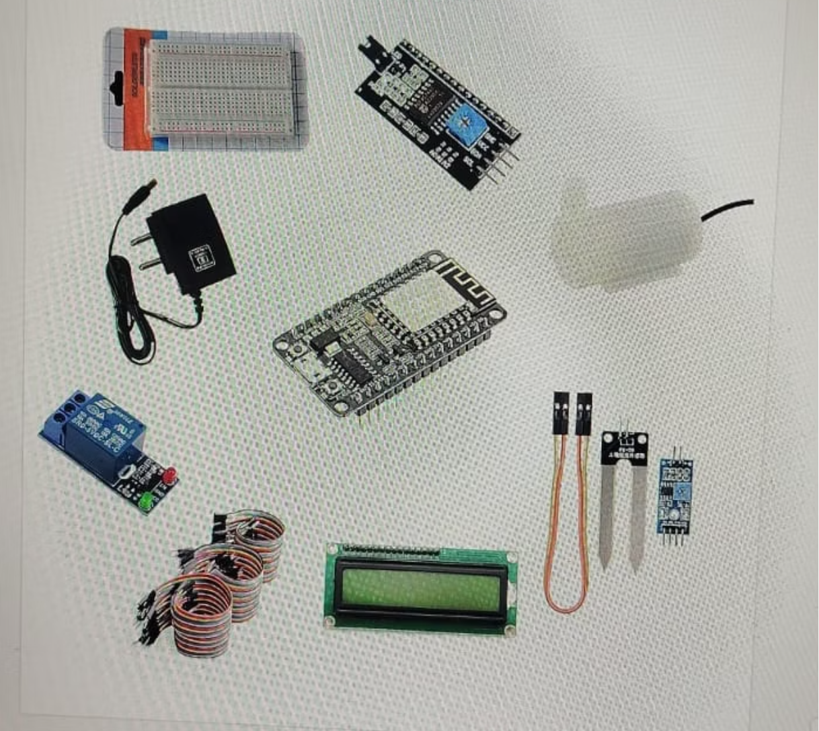
Components Used
ESP32 Microcontroller
Capacitive Soil Moisture Sensor
DHT11/22 Temperature and Humidity Sensor
Relay Module
Water Pump
Silicon tube(3.3mm)
Power Supply(Arduino&ESP32)
Soldered PCB Board
Jumper Wires
Breadboard

Slide 7
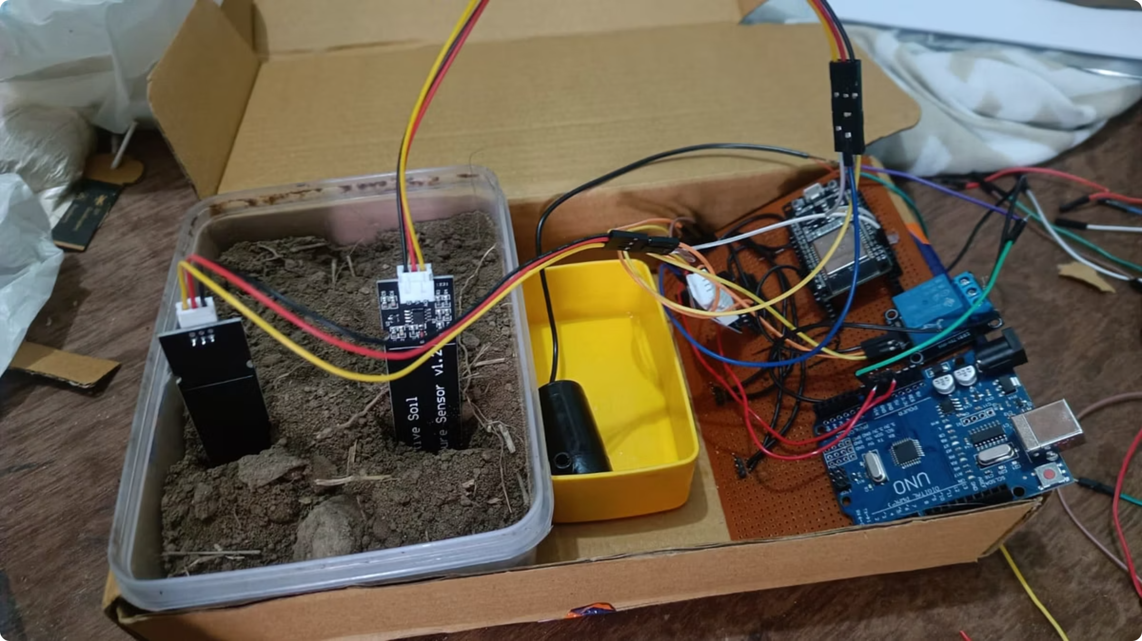
Working of the model
The system uses sensors such as DHT11 for temperature and humidity, and capacitive soil moisture sensors for real-time data collection. The ESP8266 microcontroller transmits the collected data to the IoT cloud and the farmer's mobile application. A rainwater harvesting tank is connected with the irrigation unit, which releases water based on soil moisture data. The system also checks weather forecasts via Google Weather API — if rainfall is predicted, irrigation is paused to conserve water. All operations are visualized and controlled through the IoT mobile app, allowing farmers to monitor and manage irrigation remotely.

Slide 8
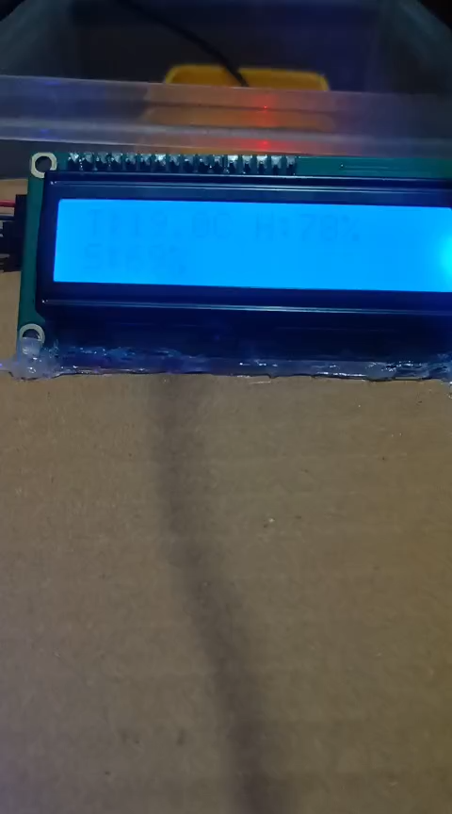
Working Flow
Sensor
ESP32
Relay ON/OFF
Threshold Logic
Pump Irrigation

Slide 9
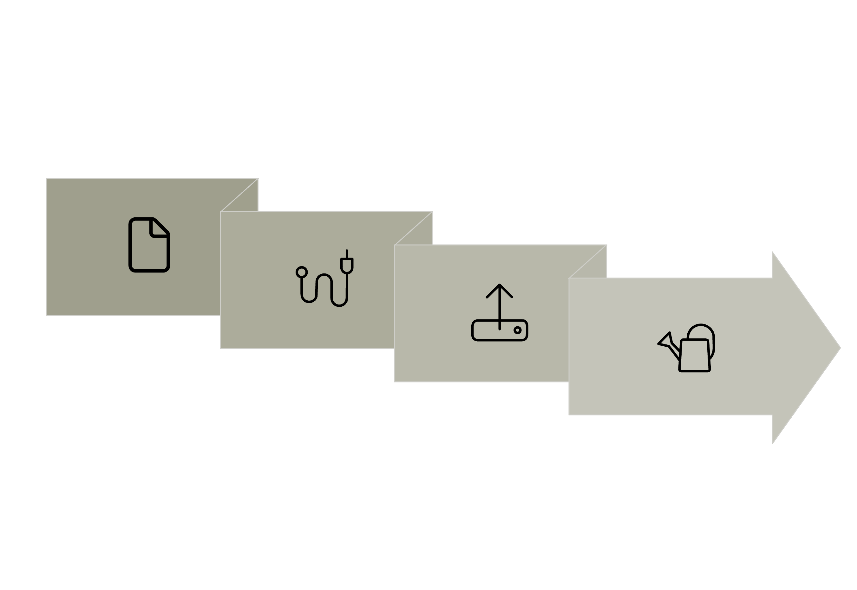

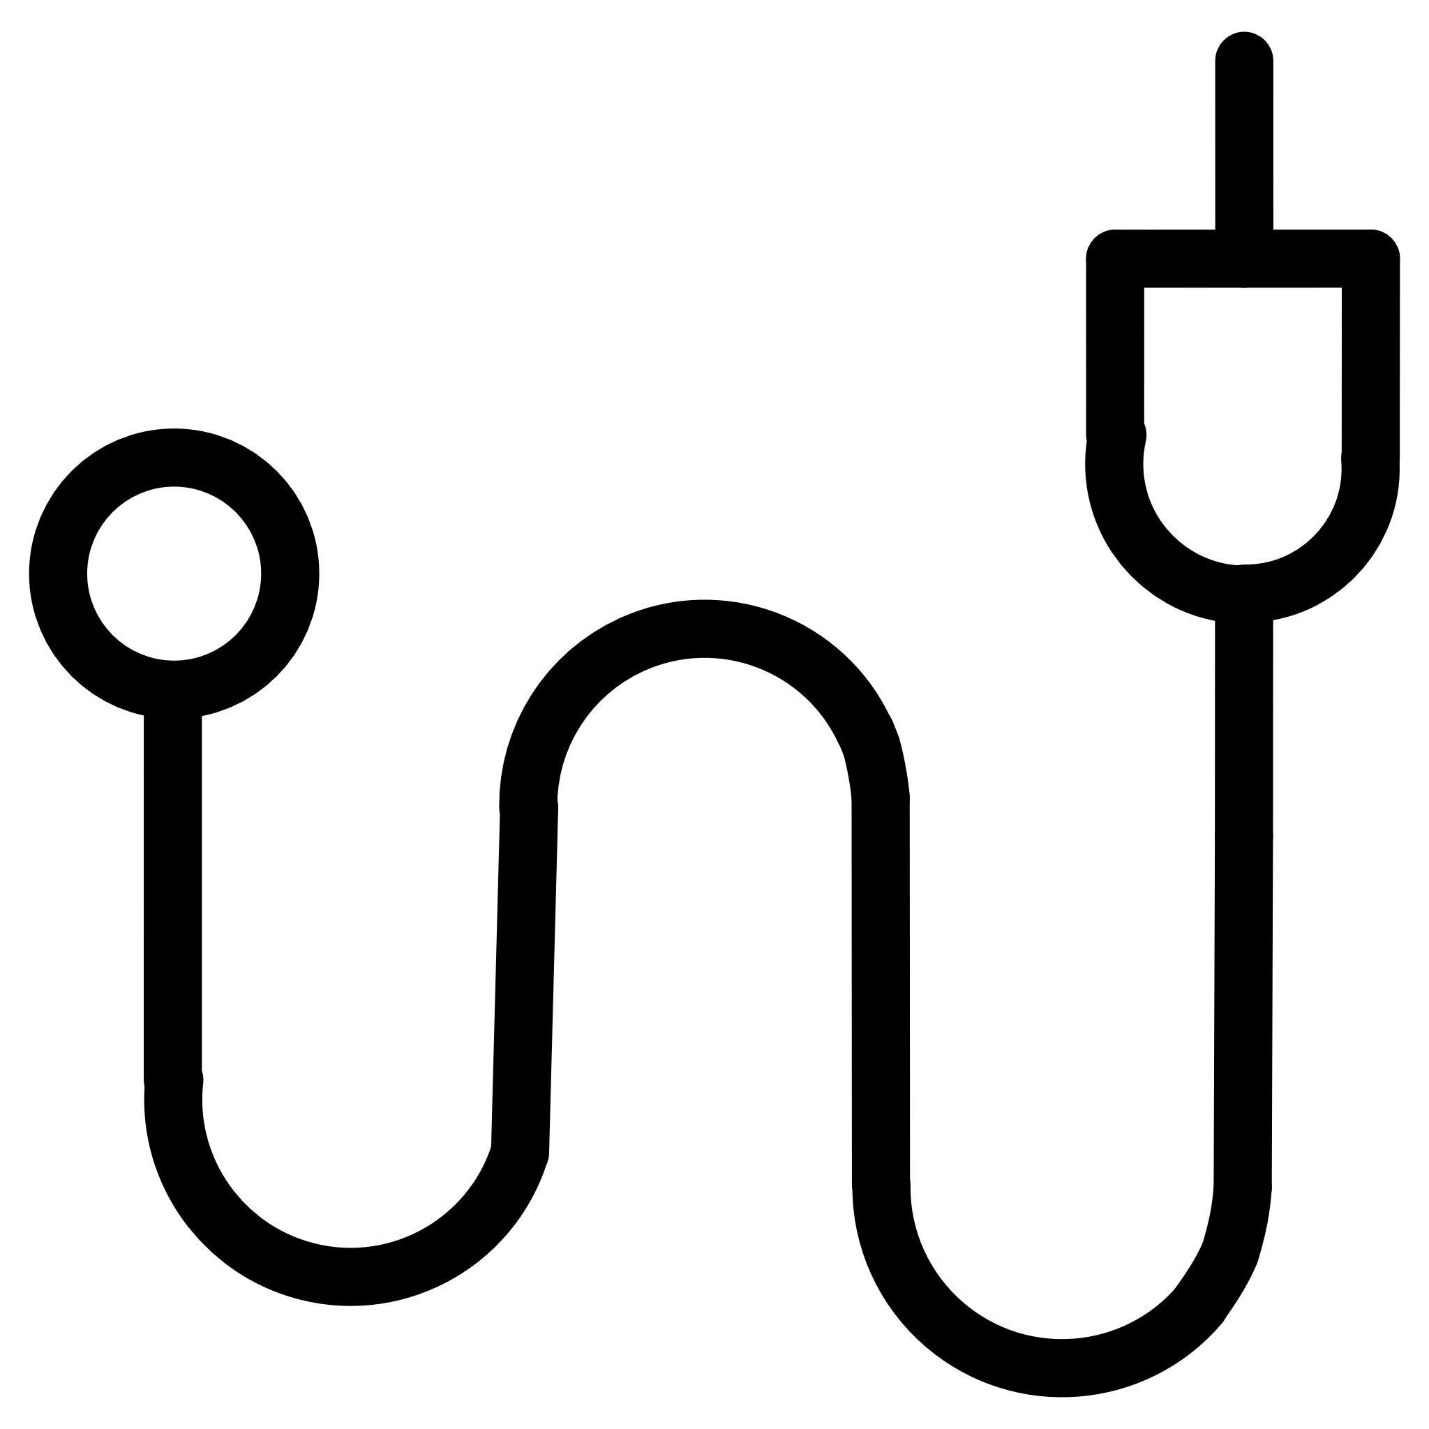
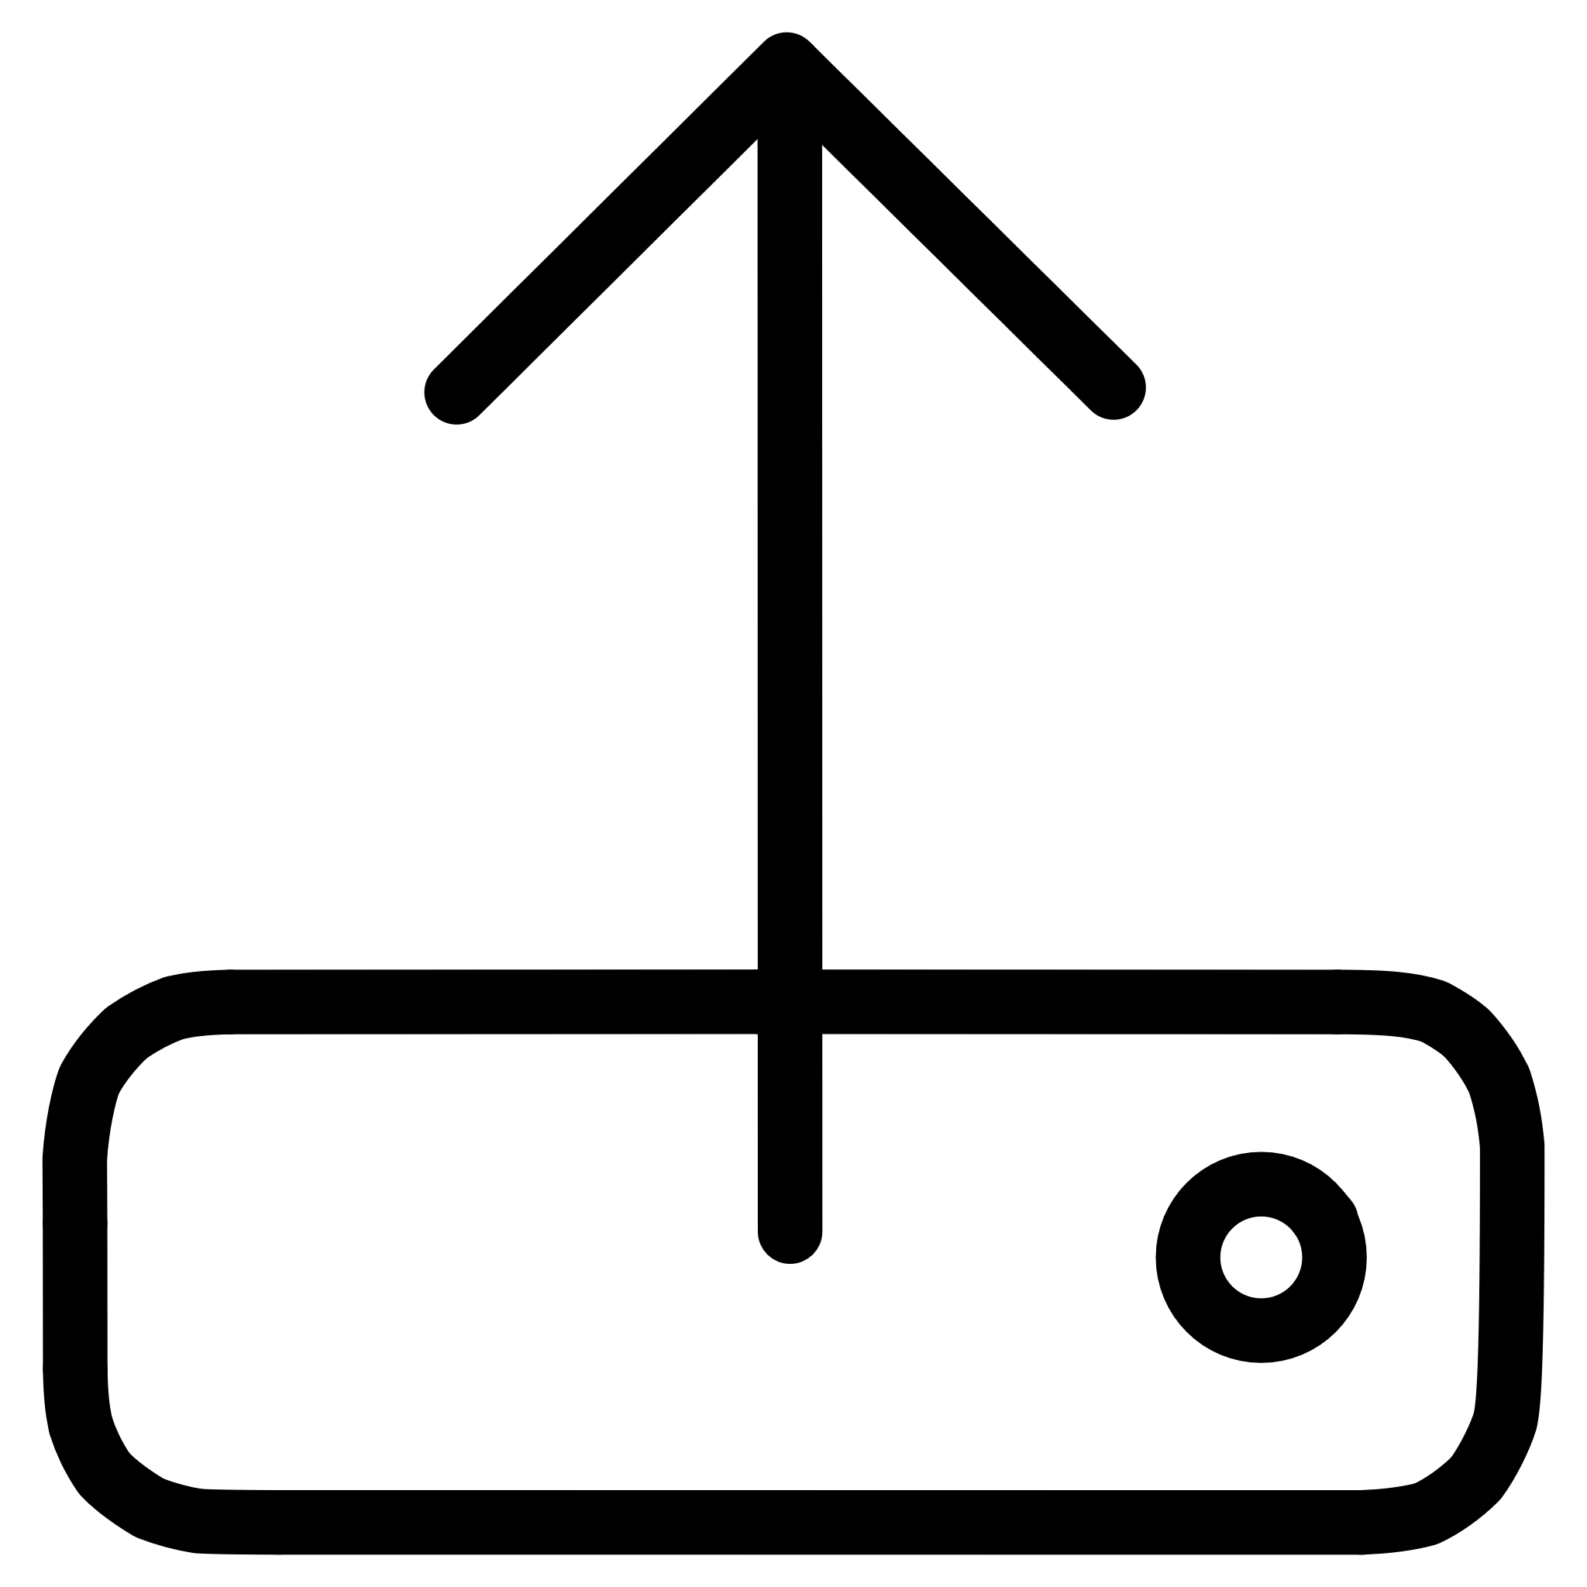

Logic flow diagram
Data Wire
Irrigation Control
Sensors
Cloud & API

Slide 10





Future Perspective
Efficient use of water resources through automation and weather-based control.
Reduction in manual labor and human errors in irrigation management.
Real-time feedback on soil and weather conditions.
Improved crop productivity and sustainability through smart recommendations.
Prototype demonstration of smart drip irrigation integrated with rainwater harvesting.

Slide 11
Contribution Page
Yash
Hrishi
Vikash
Rituraj
He wrote the synopsis and
has been greatly helpful for
making the website and the
application on blynk
He made the hardware and
efforts in providing all the
parts. He did all nighters just to
understand the ciruits.
He brought up the initial idea
and made the IEEE format as well
as helped Vikash with the hardware.
He has done the research and implementation of logic. Even made the presentation all by himself.

